Slide 1
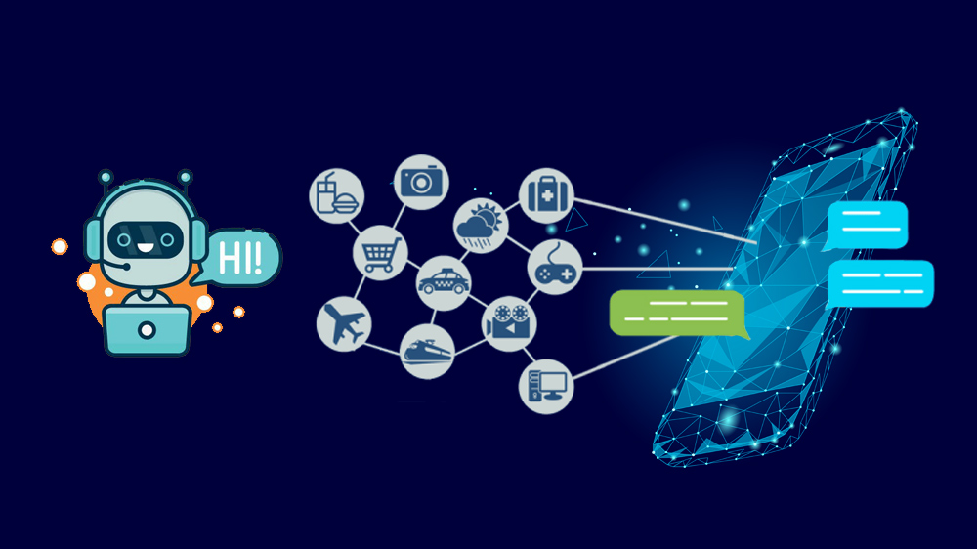
UniBuddy

Slide 2

Presentation Outline
Introduction
Preliminary Analysis
Data Collection
Roadmap

Slide 3
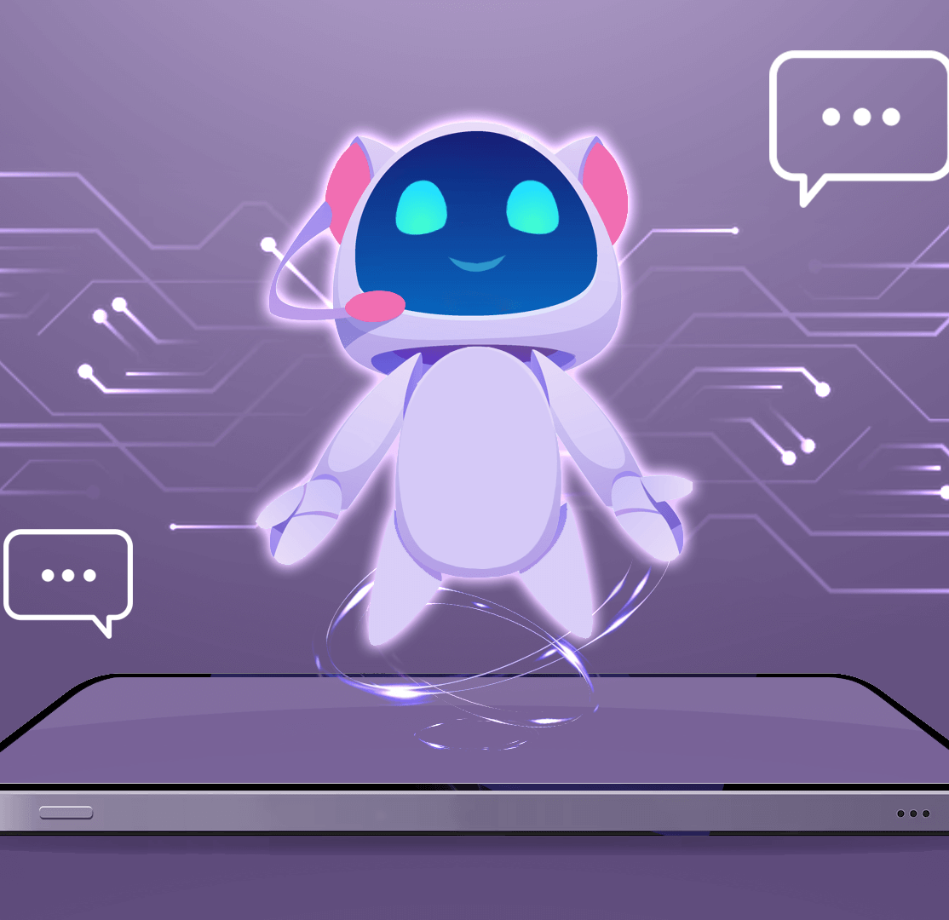
Introduction
In the modern age, universities facing lot of challenges in effectively engaging with their students and providing timely support.
As technology continues to advance, there emerges an opportunity to revolutionize the way universities interact with their student body: the creation of UniBuddy.
This UniBuddy offers strategic response to pressing need, serves as a communication channel to enhnce student experience by leveraging artificial and natural language processing capabilities.
This UniBuddy offers students personalized and efficient means to access information, seek assistance, and navigate campus resources.

Slide 4
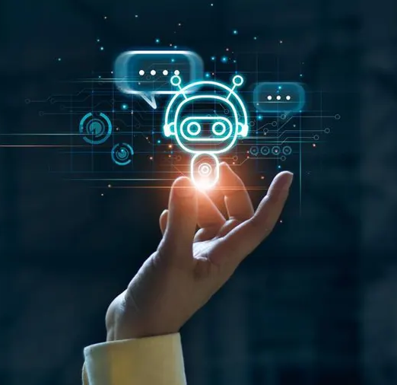
Data Collection
LangChain is configured to interface with various external data sources relevant to universities.
UnstructuredURLLoader will extract data from web pages according to the defined scraping strategy and store it in a structured format suitable for further processing.
This may involve parsing HTML content, extracting text, and storing it in a database or data repository.

Slide 5
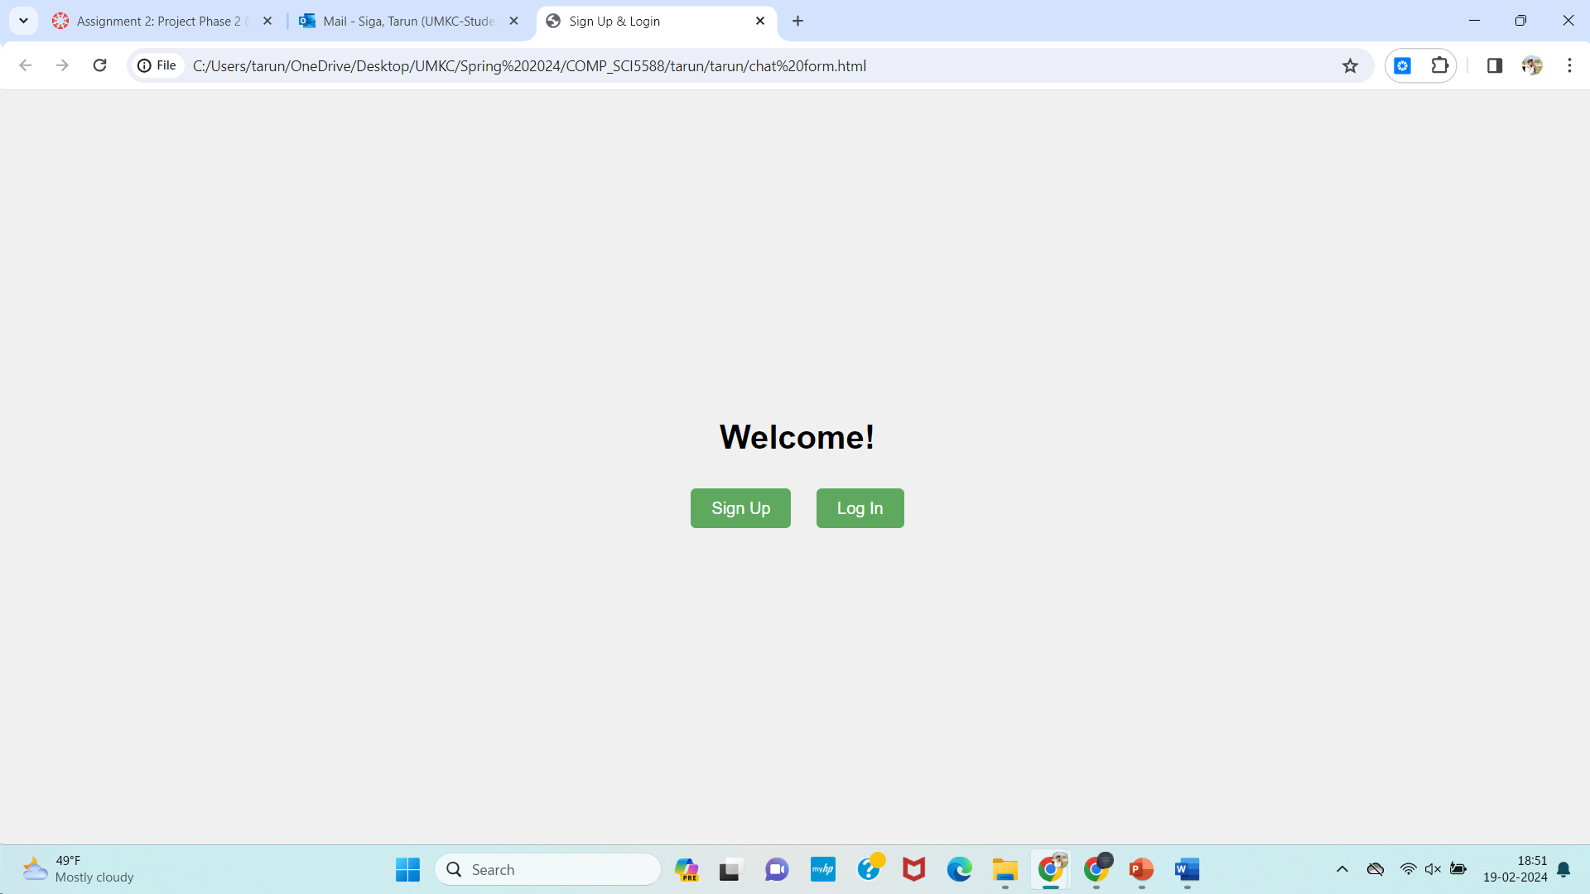
Preliminary Analysis: Front – End
We have created a page that a message with ‘Welcome’ and followed by ‘Sign up’ and ‘Login’
This page is created using HTML and Java Script

Slide 6
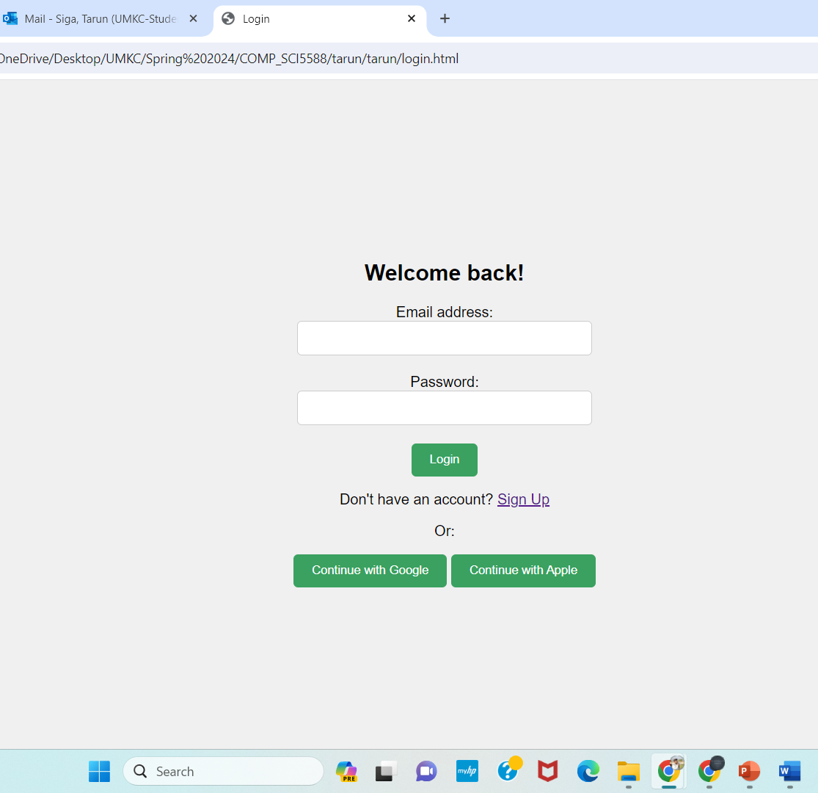
Preliminary Analysis: Front – End
For the front-end part, we have created a ‘Login’ page.
This page is created using HTML and Java Script

Slide 7
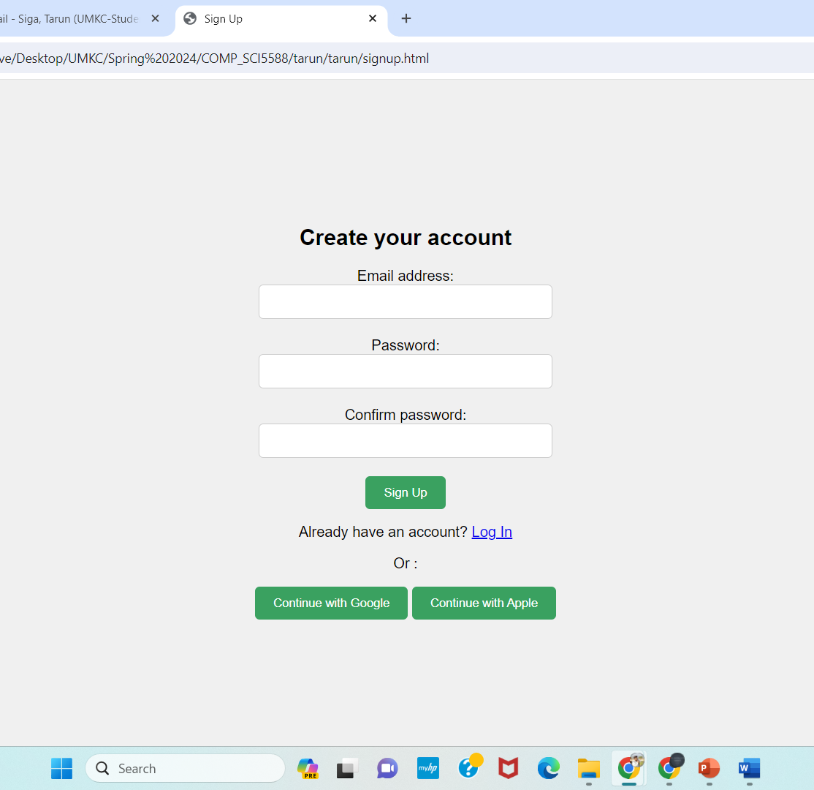
Preliminary Analysis: Front – End
We also created a ‘Sign Up’ page.
This page is created using HTML and Java Script

Slide 8
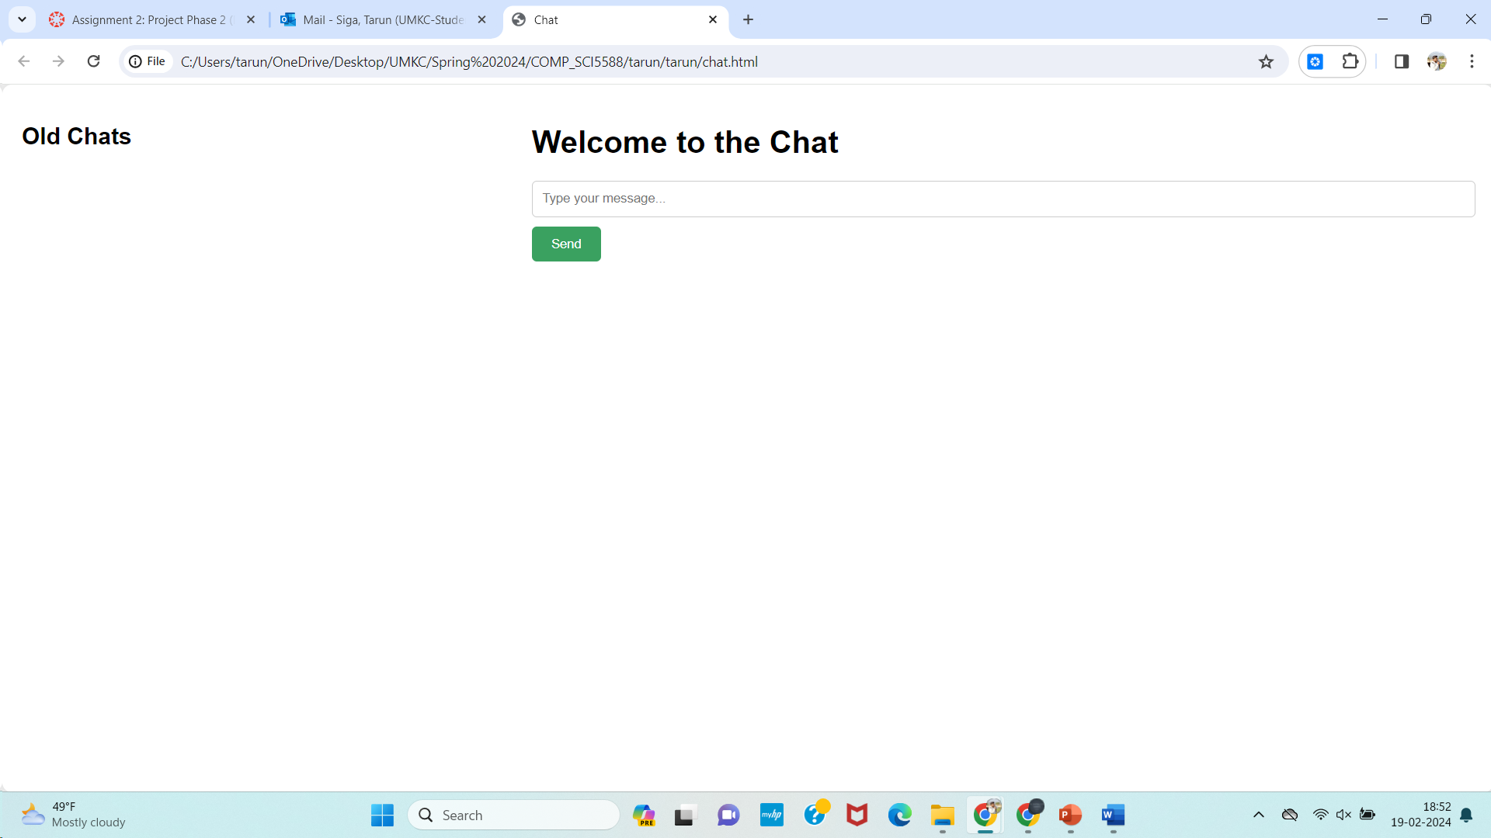
Preliminary Analysis: Front – End
This is the interface for the UniBuddy.
We can find out history under old chats.
We can start a new conversation with UniBuddy.

Slide 9
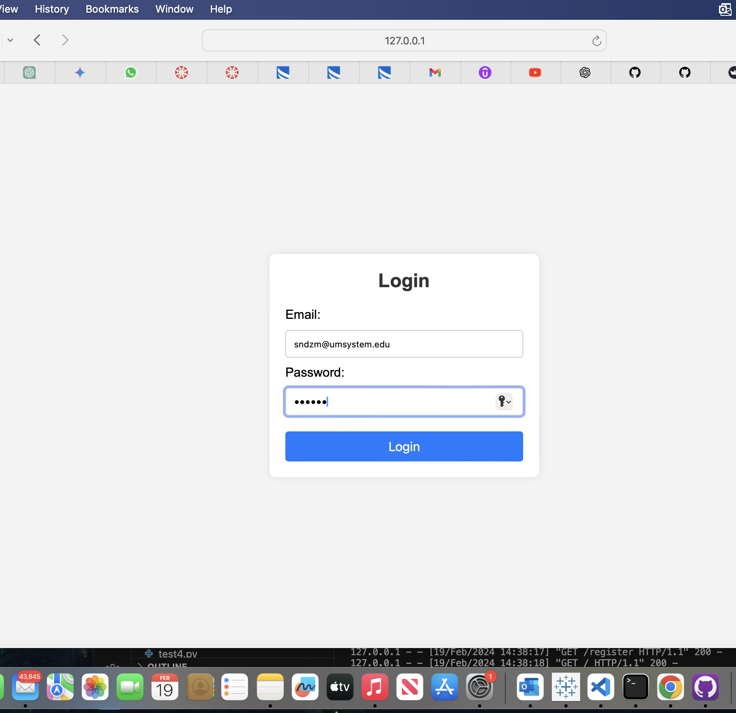
Preliminary Analysis: Back – End
Implemented a user registration and login functionality using Flask and Firebase Authentication.

Slide 10
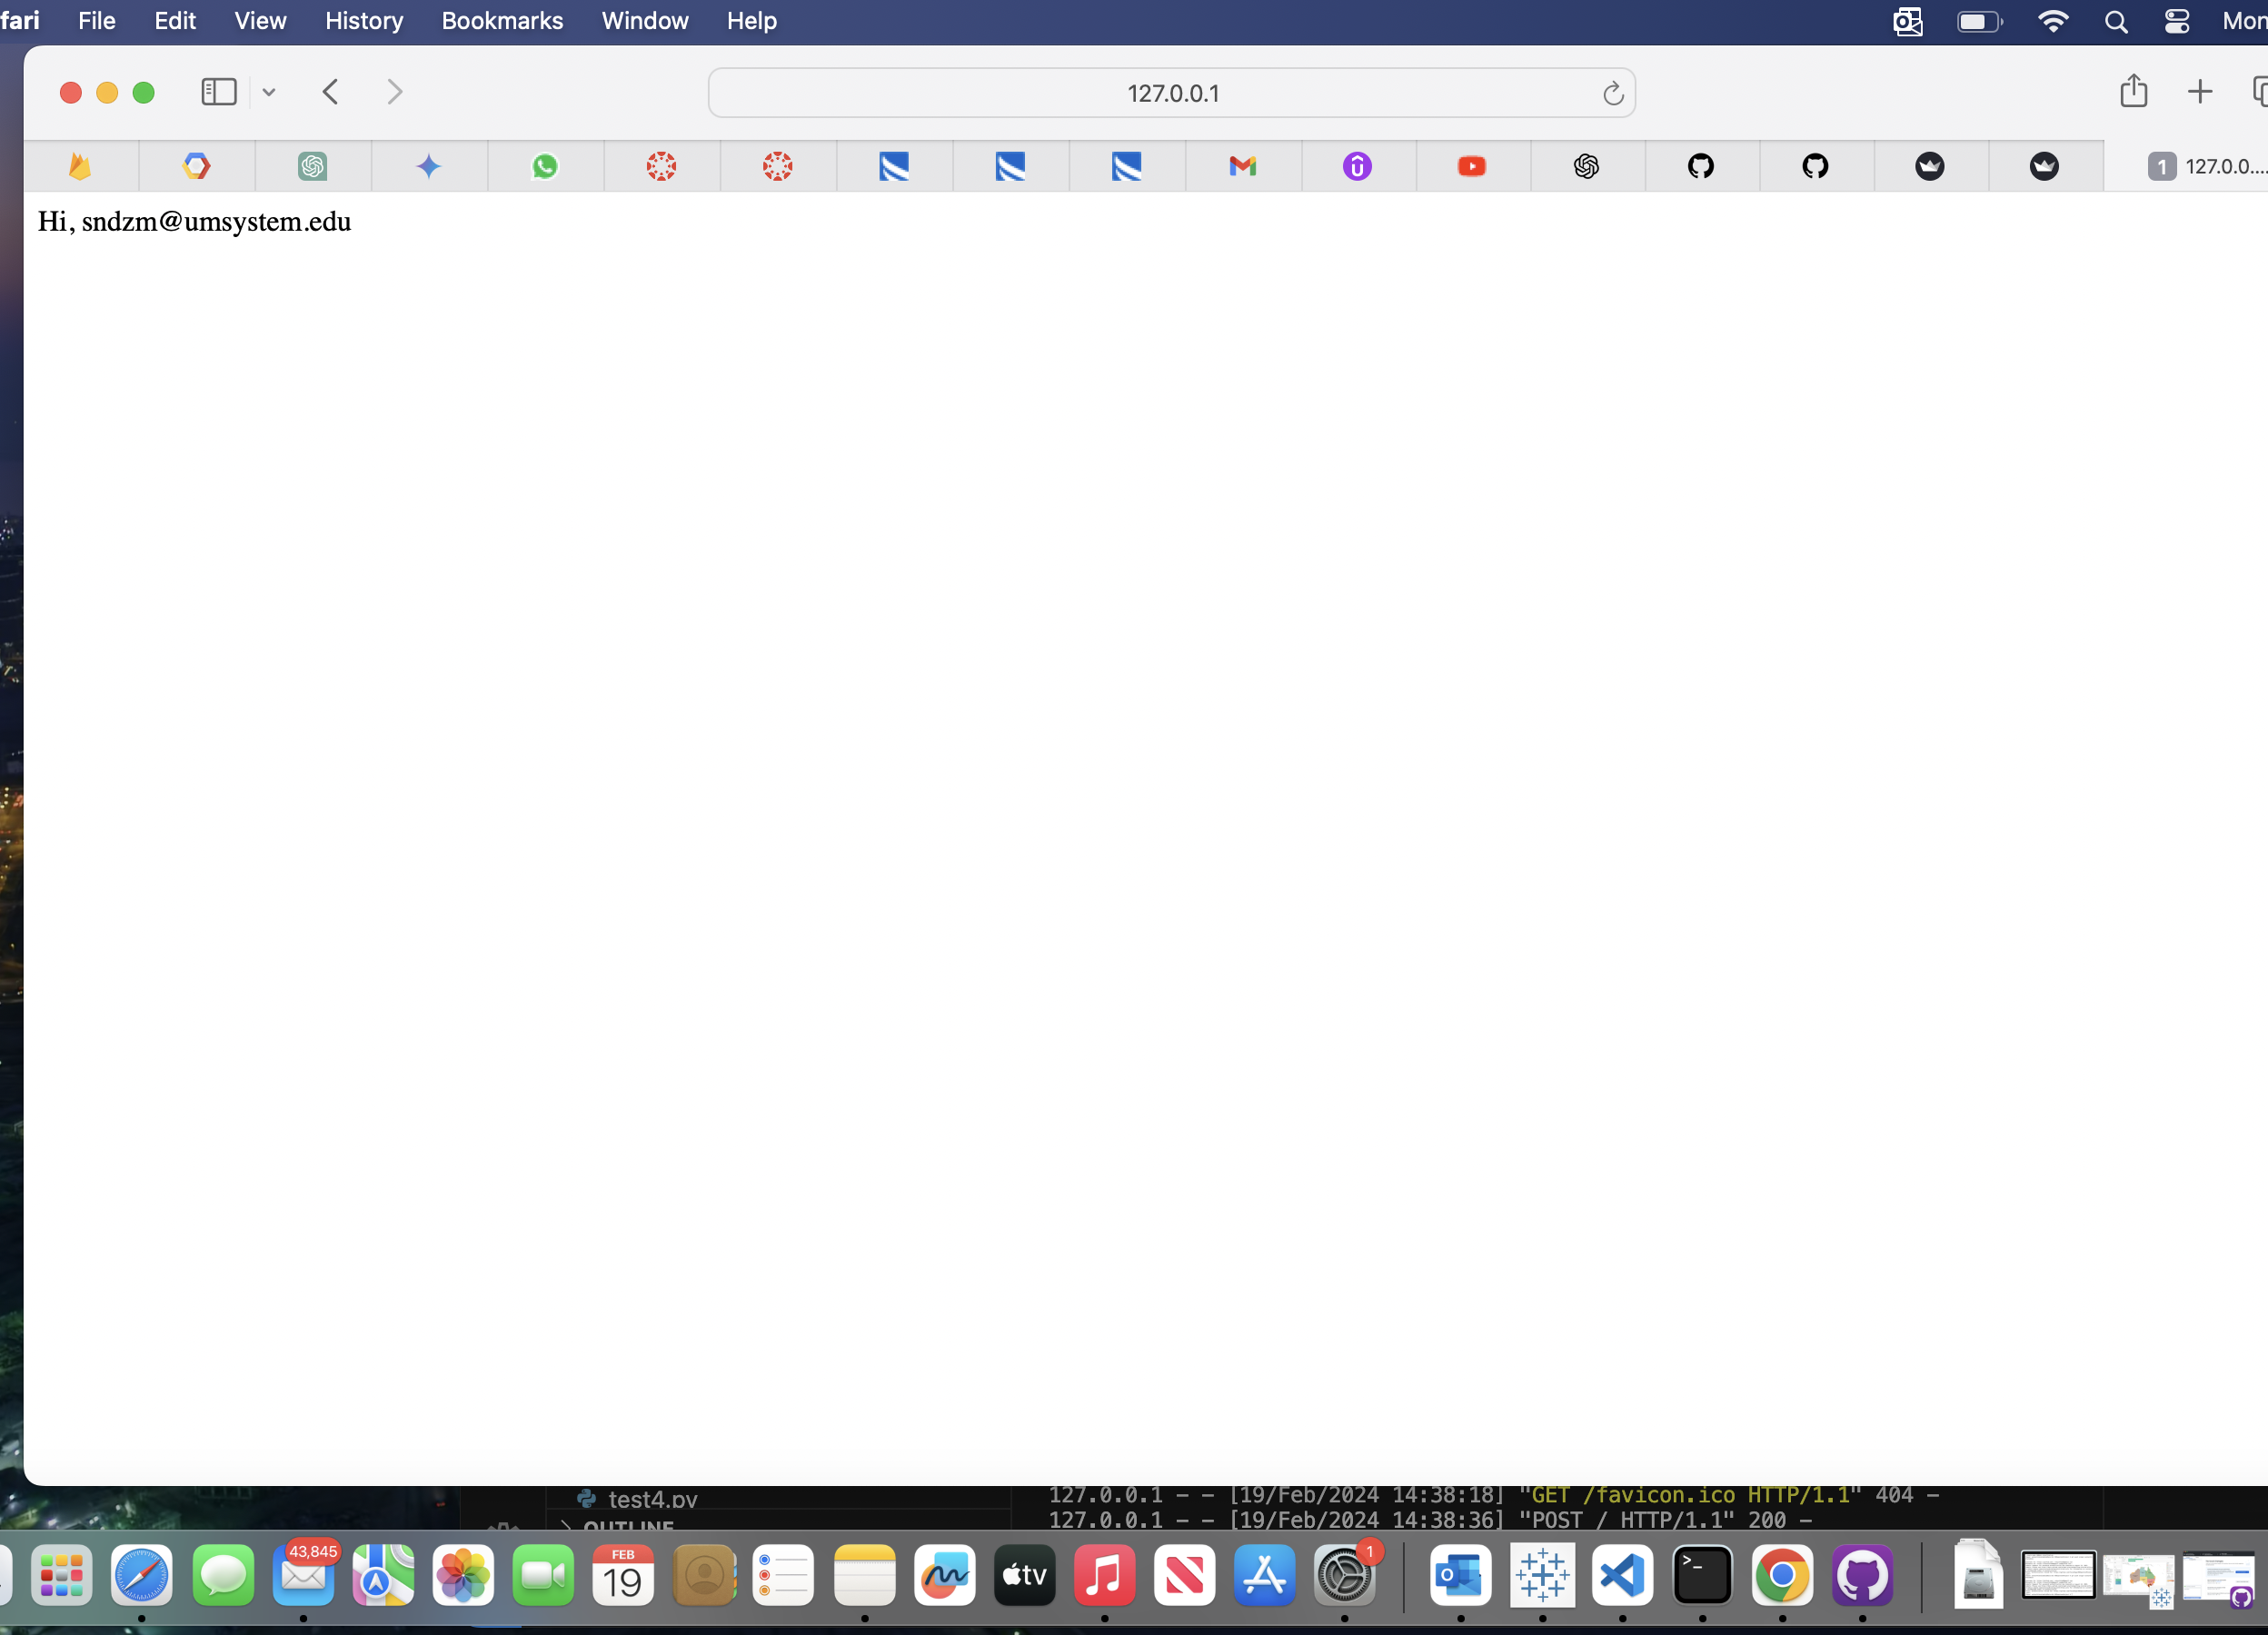
Preliminary Analysis: Back – End
Integrated Firebase Authentication for secure user authentication using email and password.

Slide 11
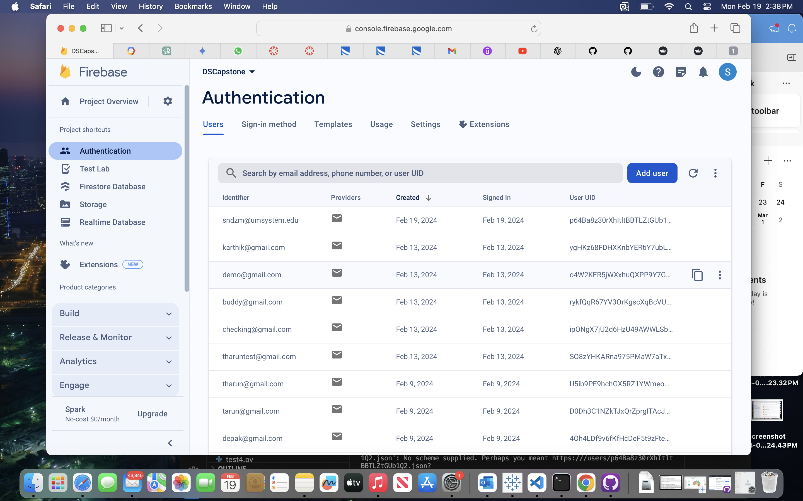
Preliminary Analysis: Back – End
The registered details of a user are stored in the Authentication service.

Slide 12
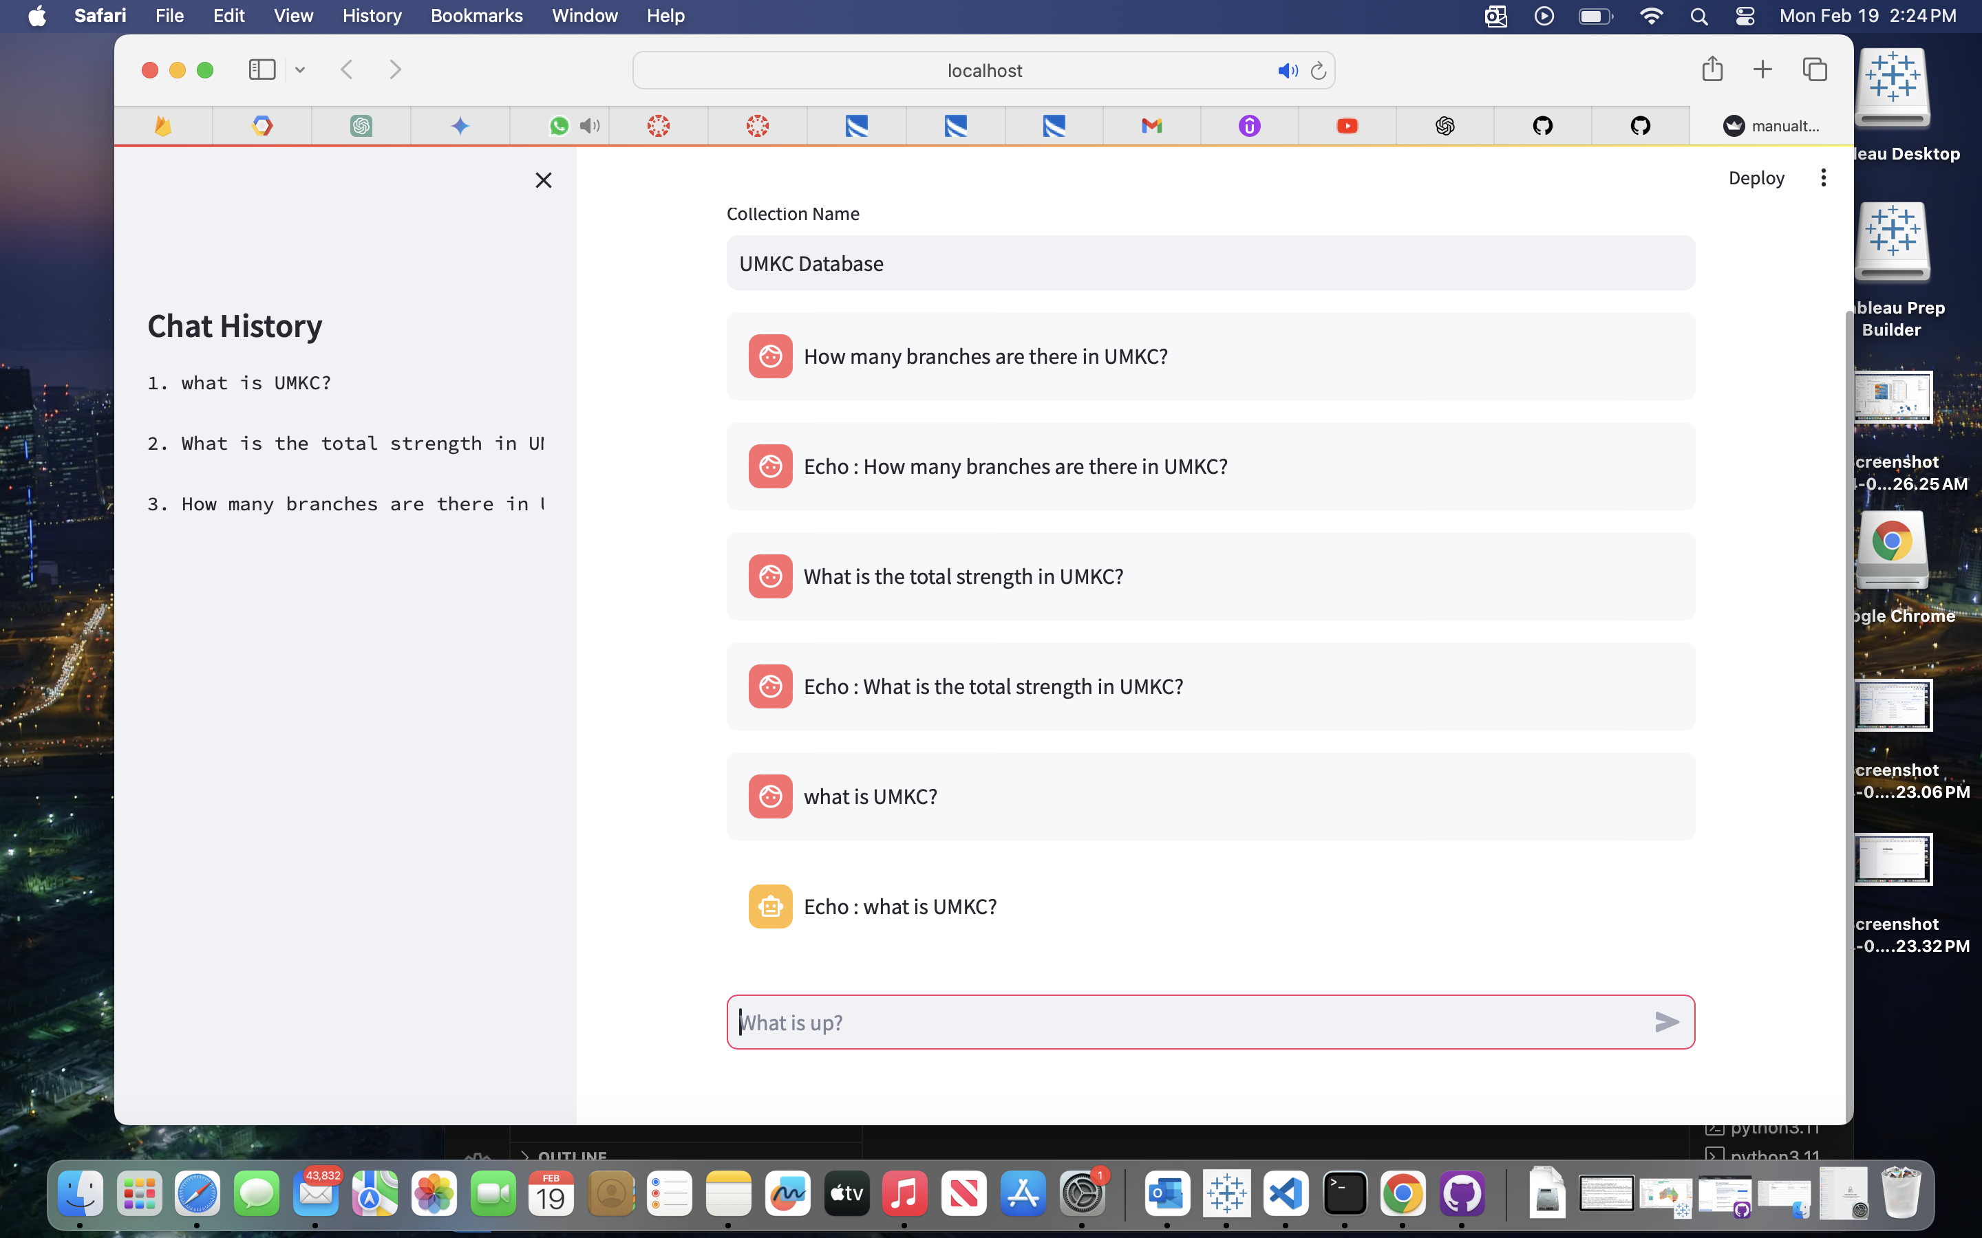
Preliminary Analysis: Back – End
The code creates a chatbot application called "UniBuddy" that allows users to interact with it through text-based prompts and responses.
Cloud Firestore is employed to store chat history and user data.
We are displaying the chat history with the latest query appearing first.

Slide 13
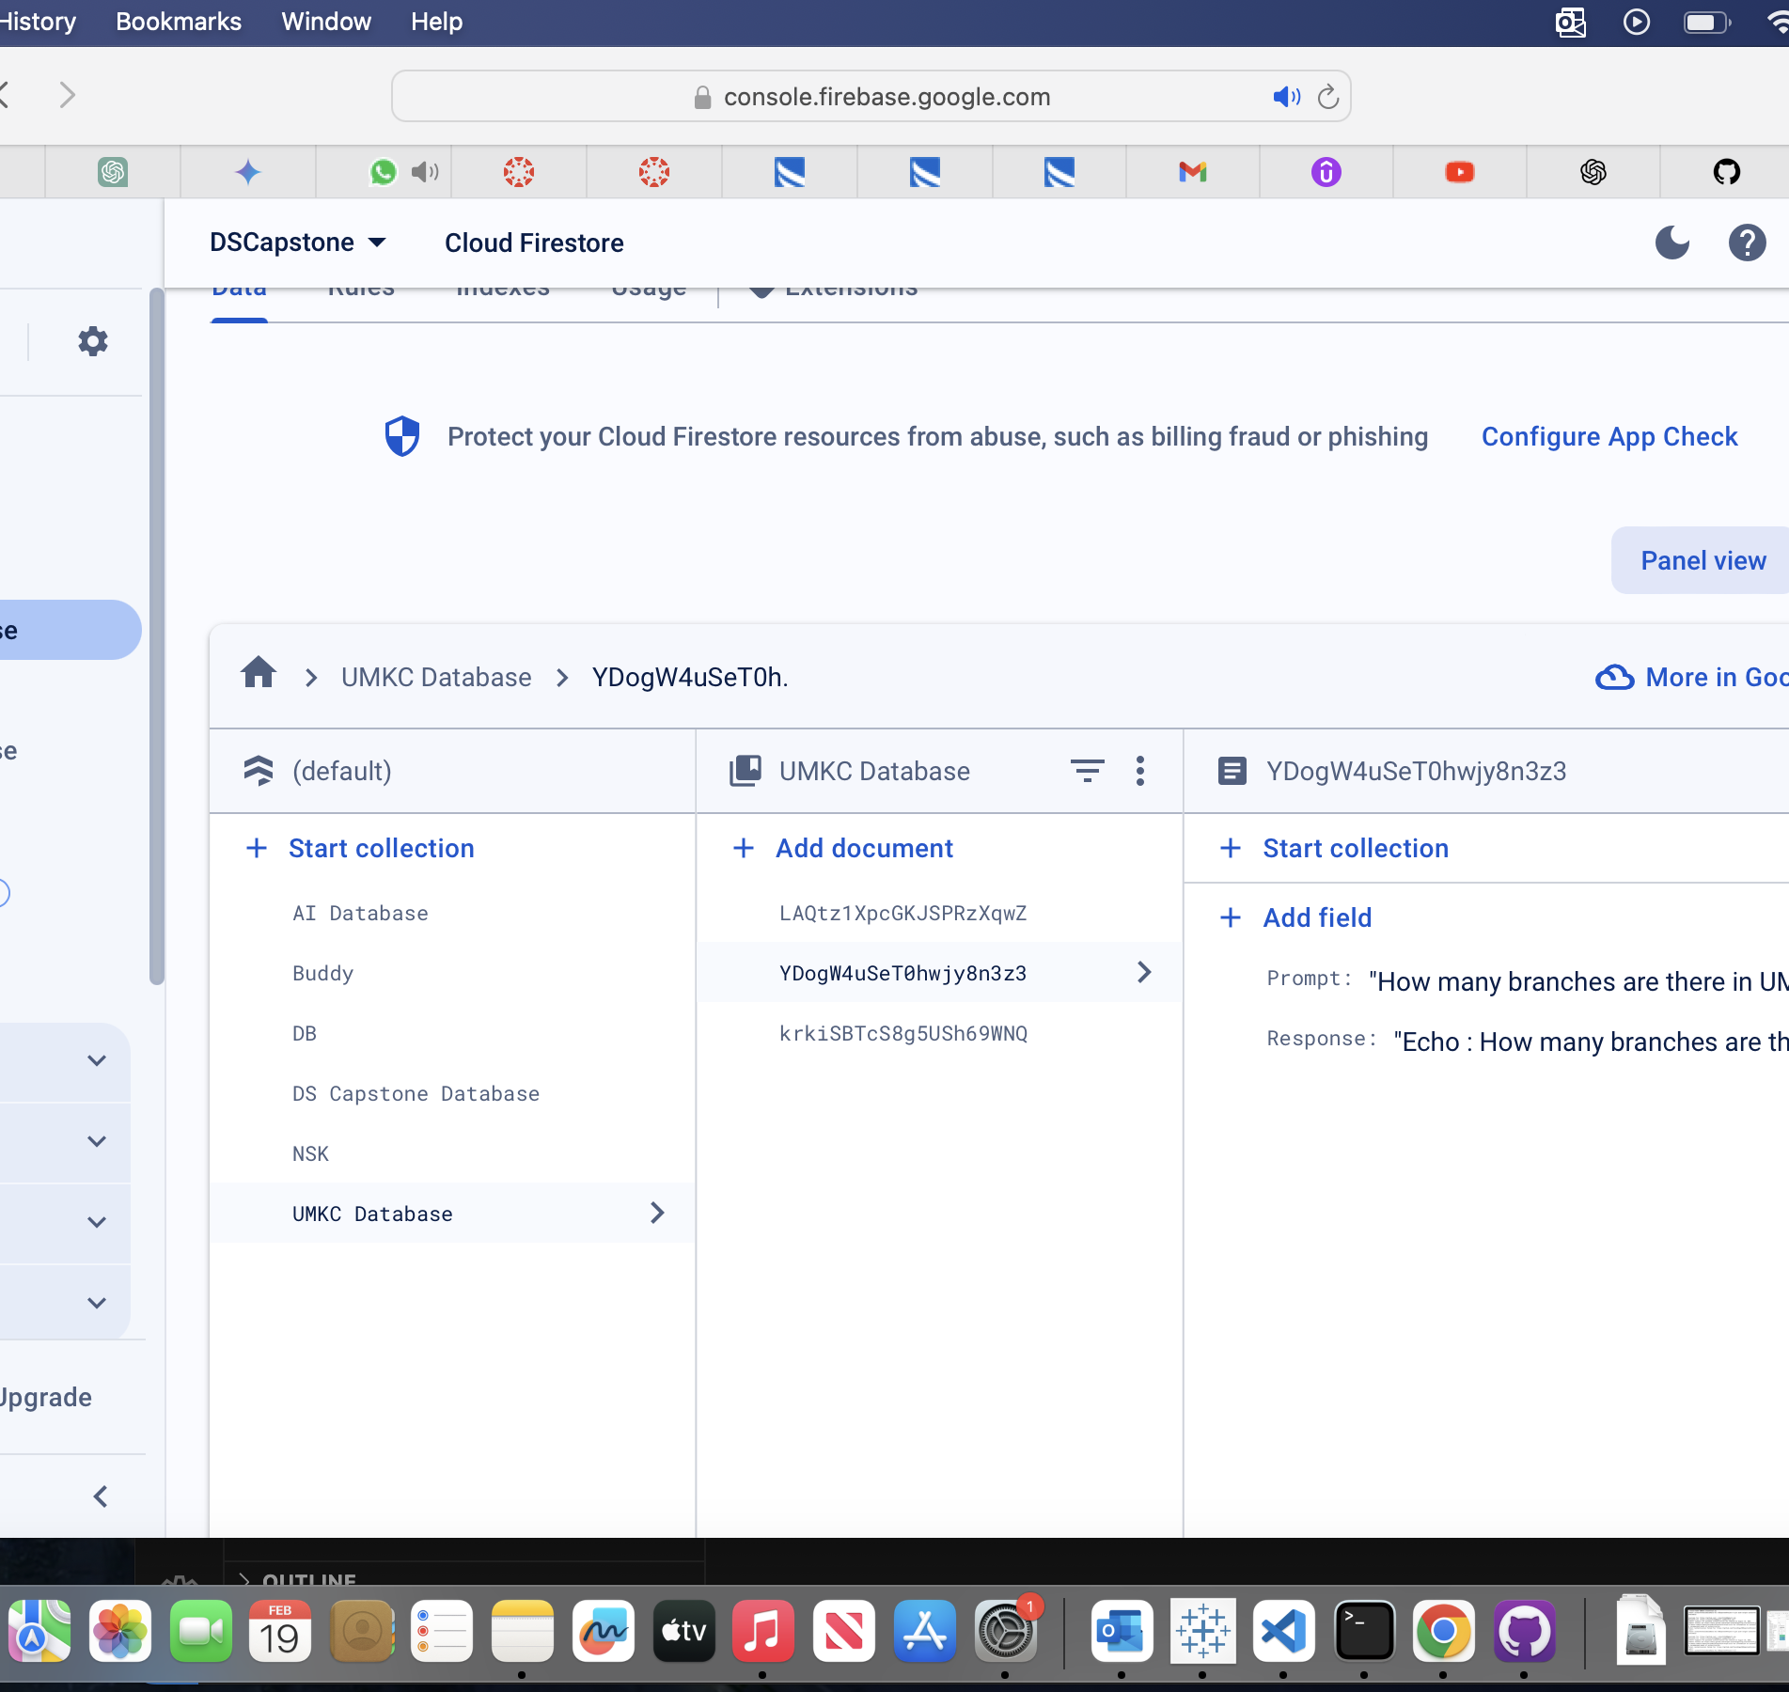
Preliminary Analysis: Database
Each user's chat history, including both prompts and responses, is stored in a dedicated collection within Firebase for data analysis.

Slide 14
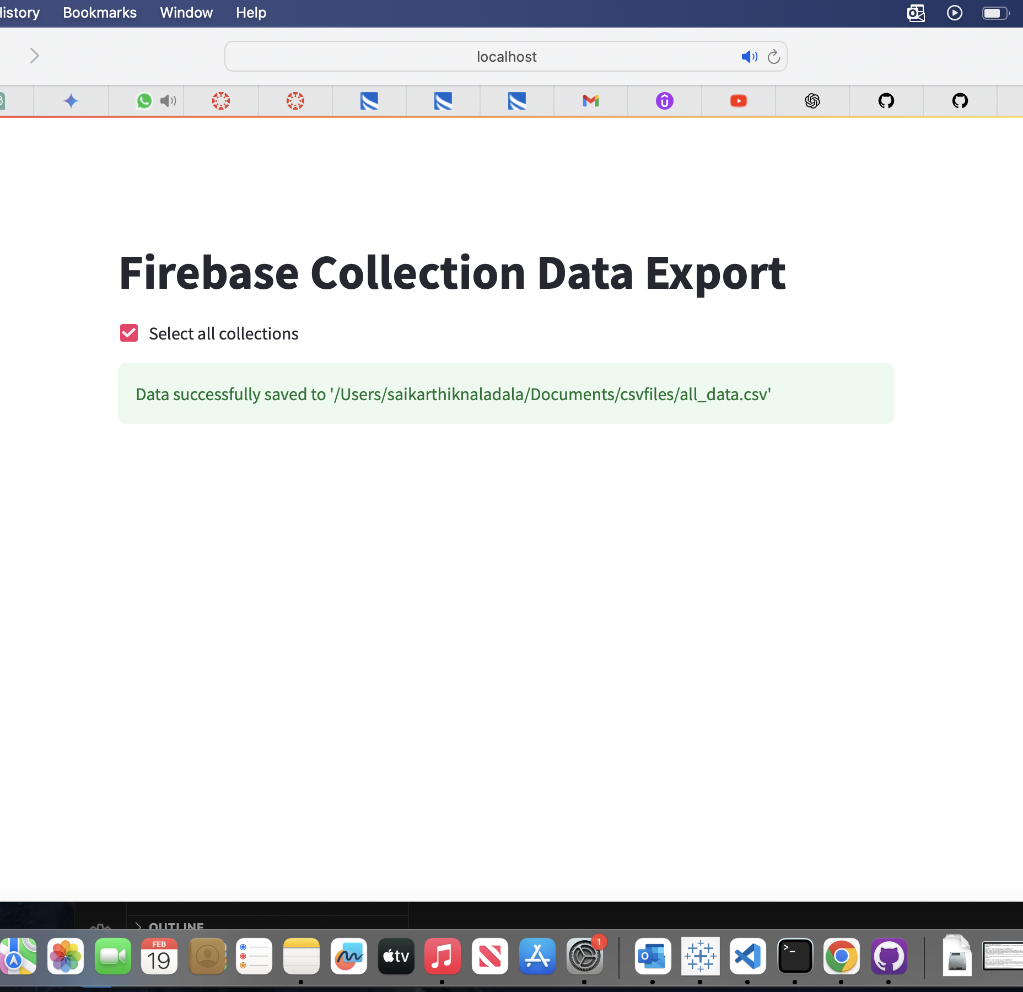
Preliminary Analysis: Chat Data Export
We implemented a feature to export chat data to CSV format for future analysis using Business Intelligence tools like Tableau etc.
Admin can be able to select specific collections or export all collections.

Slide 15
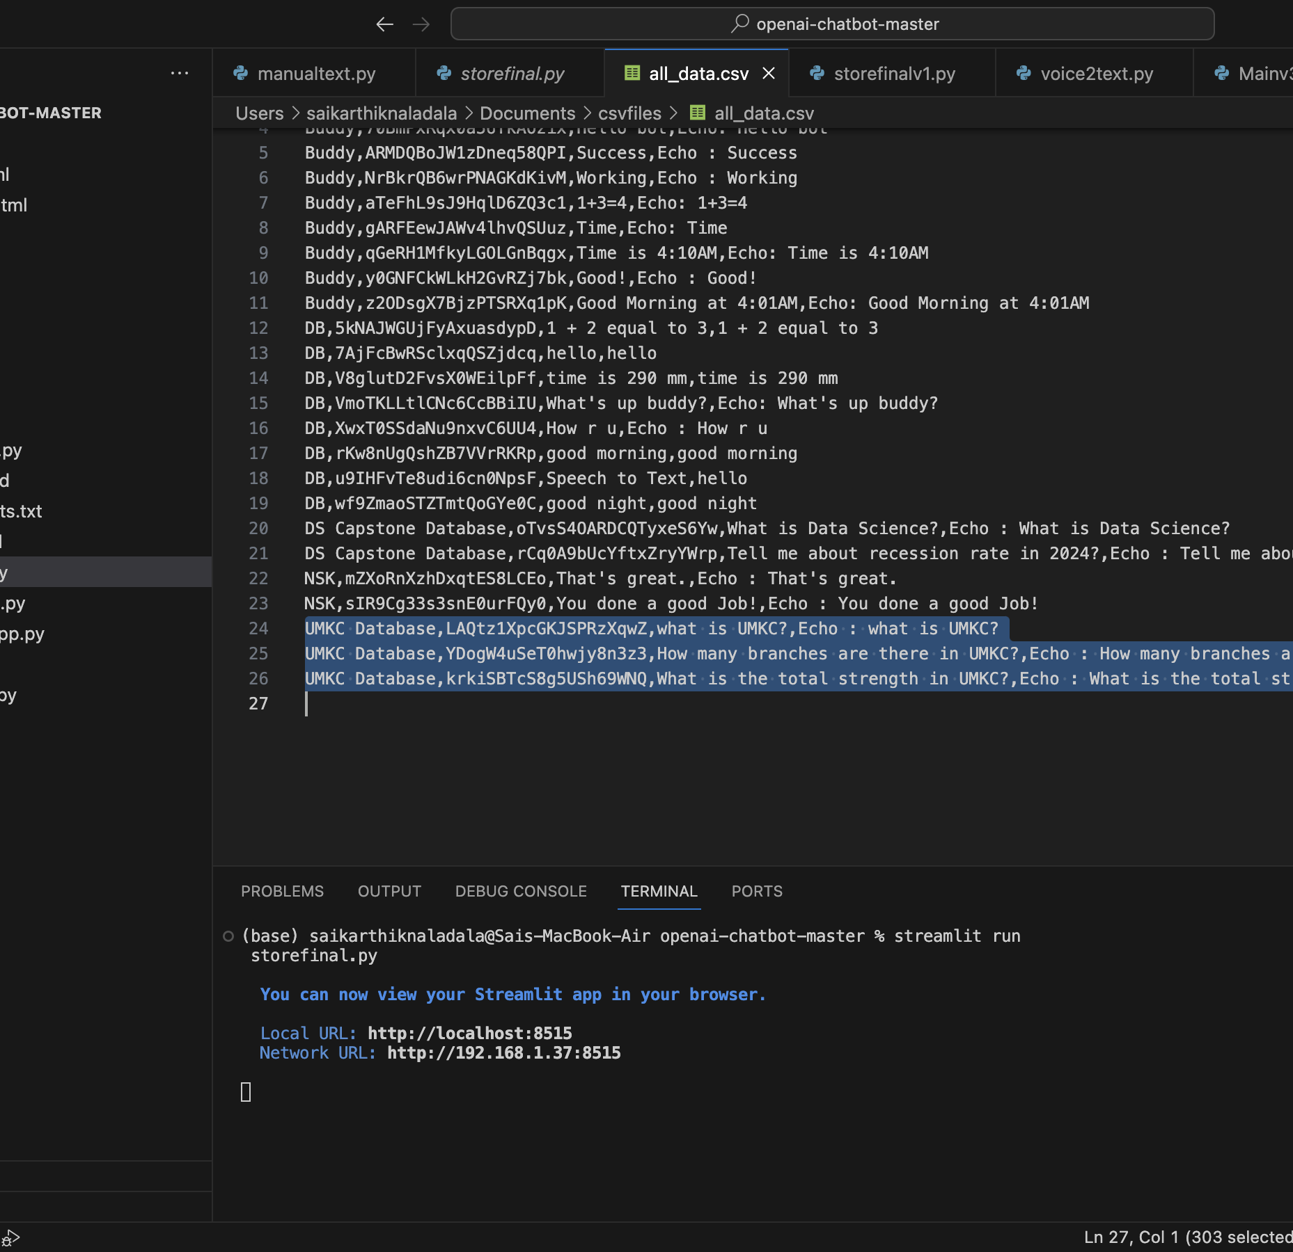
Preliminary Analysis: CSV File
Showing the saved CSV file

Slide 16
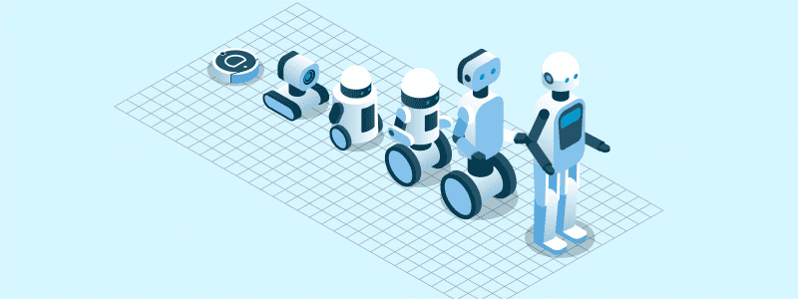
Road Map
We need to implement voice-to-text dictation functionality.
The final CSV file needs to be analyzed using Tableau.
We also want to work on CSS styling.
Additionally, we need to specify professional field names for data collection.
Moreover, we aim to collect more data for model training and improve the performance of fine-tuning.

Slide 17
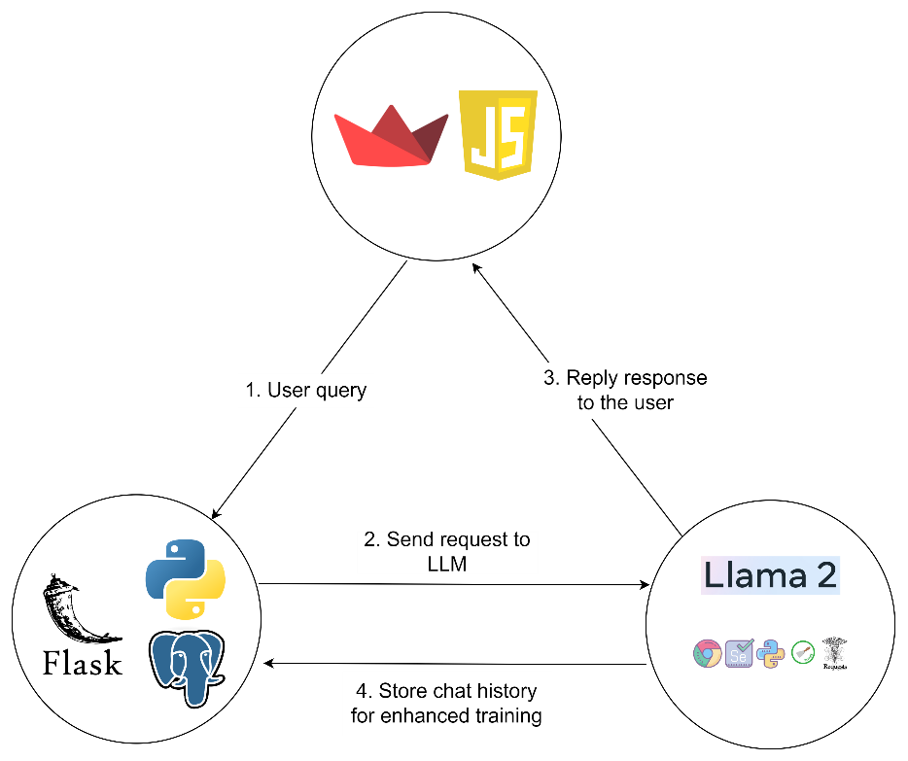
Triangle Architecture

Slide 18

GitHub Links
Project GitHub Link:
https://github.com/TarunSiga/DSCapstoneProject
Individual GitHub links (Branched with project):
Deepka Ayyasamy:
https://github.com/TarunSiga/DSCapstoneProject/tree/DeepakAyyasamy
Tarun Siga:
https://github.com/TarunSiga/DSCapstoneProject/tree/TarunSiga
Sai Karthik Naladala:
https://github.com/TarunSiga/DSCapstoneProject/tree/saikarthiknaladala

Slide 19

Thank You! Deepak Ayyasamy Tarun Siga Sai Karthik Naladala

